Slide 1
MATH 340 Programming in Math
Spring 2019
Professor George

Slide 2
MATH 340 Programming in Math
Course web page: Course material (notebooks and syllabus) can be found on Github at:
https://github.com/uduakgeorge/M340
You can also view the notebooks and syllabus directly at
https://nbviewer.jupyter.org/github/uduakgeorge/M340/tree/master/Math-340-Notebooks-master/

Slide 3
MATH 340 Programming in Math
Office: GMCS 584
Office hours: Wednesdays, 11:00-11:50
Thursdays, 12:00-12:50
Email will be used as the primary mode of communication outside class. It is your responsibility to check your email at least once a day

Slide 4
MATH 340 Programming in Math
Textbook: Course Notes
Secondary Text: Scientific Computation: Python Hacking for Math Junkies, by Bruce E. Shapiro

Slide 5
MATH 340 Programming in Math
This is an exciting class, you will learn how to program in Python, typeset mathematical symbols and equations in LaTeX and use Jupyter to present mathematical results.
Homework will be submitted via Google Drive, if you do not have a gmail account, please sign up for one by following the link below: https://support.google.com/mail/answer/56256?hl=en

Slide 6
Grading policy
Your final score will consist of:
Homework (40%); One midterm (30%); Final exam (30%)
The following grading scale will be used:
A 93% - 100% A- 90% - 93%
B+ 87% - 90% B 83% - 87% B- 80% - 83%
C+ 76% - 80% C 72% - 76% C- 68% - 72%
D+ 64% - 68% D 60% -64% D- 55% - 60% F Below 55%

Slide 7
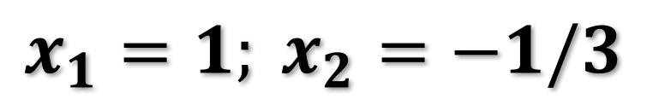
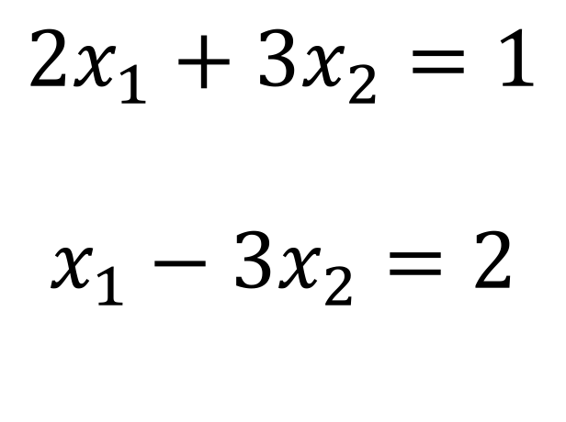
Why learn python?
Solve
$${2x}_{1}+{3x}_{2}=1$$
$$x_{1}−{3x}_{2}=2$$
Applying the substitution method to the system of equations, we obtain
the following solutions:
$$x_{1}=1; x_{2}=−1/3$$

Slide 8
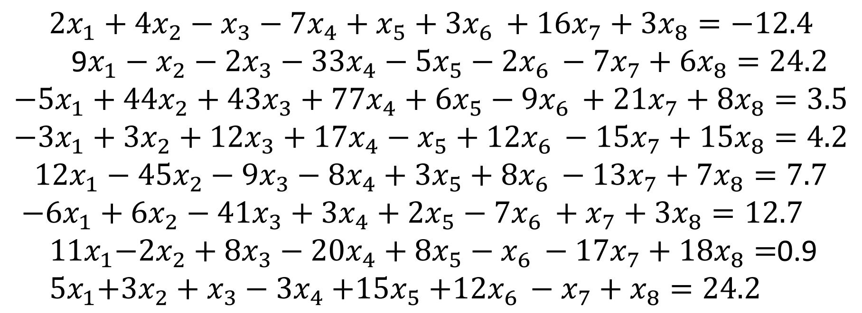
Why learn python?
Solve
$${2x}_{1}+{4x}_{2}−x_{3}−{7x}_{4}+x_{5}+{3x}_{6 }+{16x}_{7}+{3x}_{8}=−12.4$$
9$x_{1}−x_{2}−{2x}_{3}−{33x}_{4}−{5x}_{5}−2x_{6 }−{7x}_{7}+{6x}_{8}=24.2$
$${−5x}_{1}+{44x}_{2}+{43x}_{3}+{77x}_{4}+{6x}_{5}−9x_{6 }+{21x}_{7}+8x_{8}=3.5$$
$${−3x}_{1}+3x_{2}+{12x}_{3}+1{7x}_{4}−x_{5}+12x_{6 }−{15x}_{7}+{15x}_{8}=4.2$$
$${12x}_{1}−{45x}_{2}−{9x}_{3}−{8x}_{4}+{3x}_{5}+8x_{6 }−{13x}_{7}+{7x}_{8}=7.7$$
${−6x}_{1}+{6x}_{2}−41x_{3}+{3x}_{4}+{2x}_{5}−7x_{6 }+x_{7}+{3x}_{8}=12.7$
${ 11x}_{1}−{2x}_{2}+8x_{3}−{20x}_{4}+{8x}_{5}−x_{6 }−{17x}_{7}+18x_{8}=$0.9
${ 5x}_{1}+3x_{2}+x_{3}−{3x}_{4}{+15x}_{5}+12x_{6 }−x_{7}+x_{8}=24.2$
Python can be used to find the solution for a large system of equations.

Slide 9
Why learn python?
Python is a programming language that enable us to use computers to solve complex, tedious or difficult tasks.
Example: The sum of numbers from 1 to 1,000,000 can be done easily in Python.

Slide 10
Programs and Programming
To tell a computer what to do you give it instructions in a computer language.
The name of the language that we will use in this class is Python.
A Computer Program is a sequence of instructions for a computer, so that it can perform a specific task.

Slide 11
Syntax and semantics
The syntax of a computer language describes very precisely how to form statements the computer understands.
If there is any deviation from the rules, even the smallest, the computer will recognize that there is an error, and it will tell you so.
The semantics of a computer program describe what it is supposed to do.
A semantic error that is not a syntactic error will not cause the program to halt. Instead, it will do something funny.

Slide 12
Programs and Programming
The instructions in a computer program are called statements.
When you program in python, the text you write is called code.

Slide 13
Why Python?
Python has generic programming structures that are common to other computer languages. If you already know another programming language, then Python is easy to learn.

Slide 14
Why Python?
It is free on all operating systems. Thus students can install it on their laptops or home computers and are not chained to computer labs or expensive license agreements.
Python is completely documented online, and there are lots of books you can download for free to learn more about it.

Slide 15
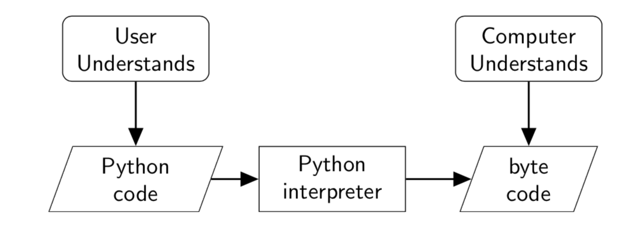
We will use the same word – python – to refer to:
the language (the syntactical rules),
the written language (the code or programs), and
the computer program that translates your python code into machine language or byte code.

Slide 16
Jupyter notebooks
One of the advantages of using notebook is that you can readily access some of the most sophisticated features of python within your browser.
Step-by-step guide to accessing Jupyter notebooks:
Go to (Start-> Anaconda-> Jupyter) to open Anaconda
In Jupyter notebook dashboard, click on new->python 2
Save the new jupyter notebook as lecture 1 demo

Slide 17
Assignment
Install Anaconda (Python 2.7 version) on your personal computer.
https://www.anaconda.com
If you do not have a gmail account, please sign up for one by following the link: https://support.google.com/mail/answer/56256?hl=en

